Slide 1
Rheumatoid Arthritis Model
Selvaraj S
MetFlux Research

Slide 2
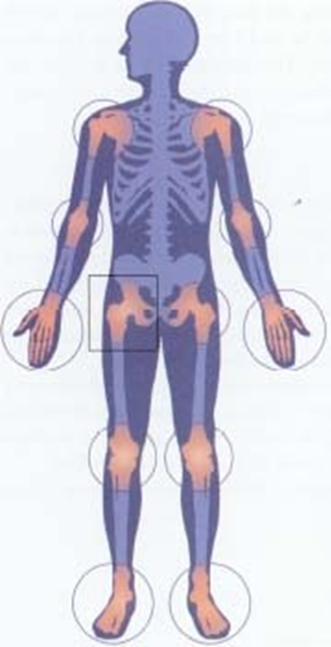
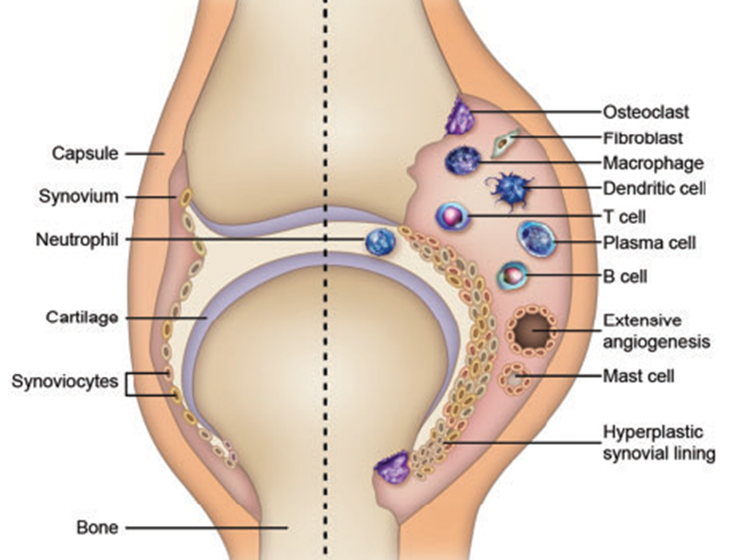
Rheumatoid Arthritis
Chronic inflammatory autoimmune disorder
Symmetrical in nature
Majorly affects joints: fingers, toes, wrists, knees, ankles, elbows, hips, and shoulders.
Non-joint structures affected: skin, eyes, lungs, heart, kidneys, salivary glands, nerve tissues, bone marrow, blood vessels.
SYMPTOMS:
Pain
Swelling
Stiffness
Inflammation
Bone erosion
Cartilage destruction
Fatigue
Angiogenesis
Fever
Loss of appetite
NORMAL
RA

Slide 3
LYMPH NODE
SYNOVIUM
Treg
OSTEOCLAST
APC ln
T CELLS
TGFβ
RANKL
IL17
IL6
T CELLS
TGFβ
FLS
IL4
Treg
Th2
Th17
Th17
IL6
IL4
IL6
TNFα
IL6
TNFα
APC s
AUTO-ANTIBODIES
AUTO-ANTIBODIES
Beta (Citrullination)

Slide 4
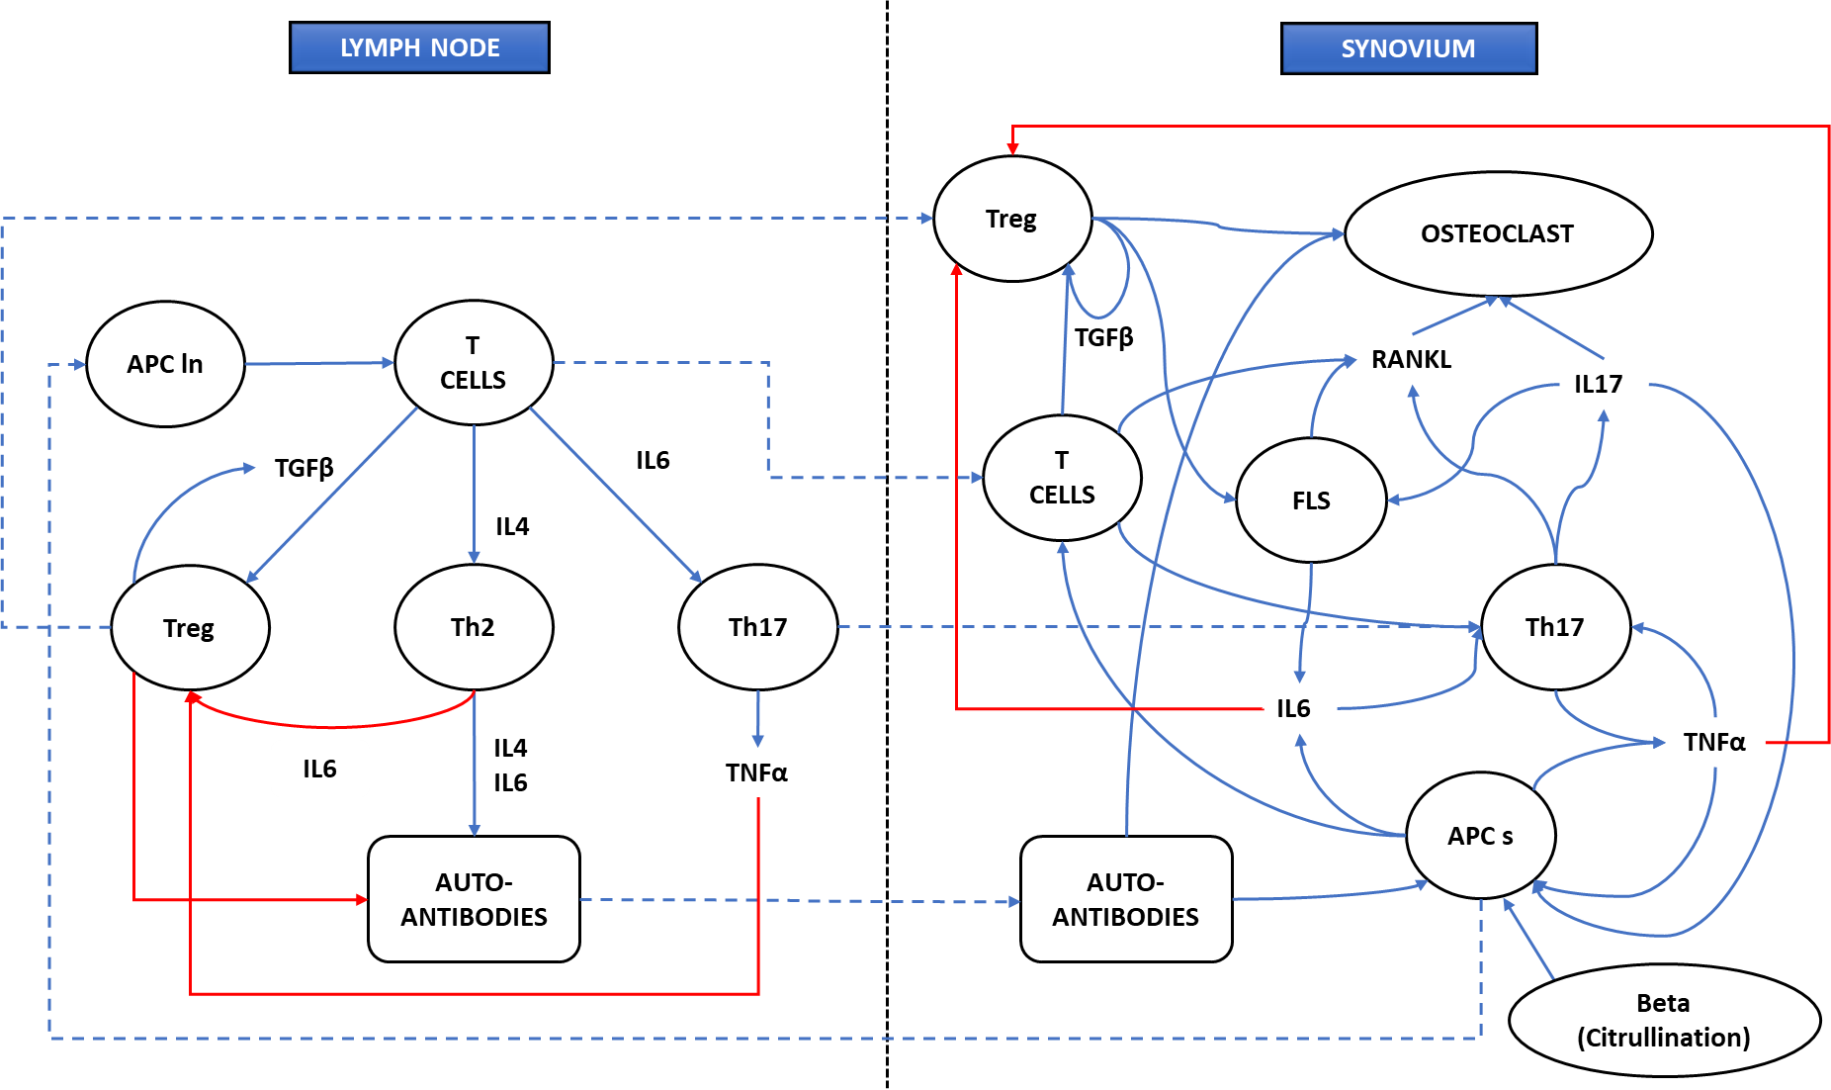
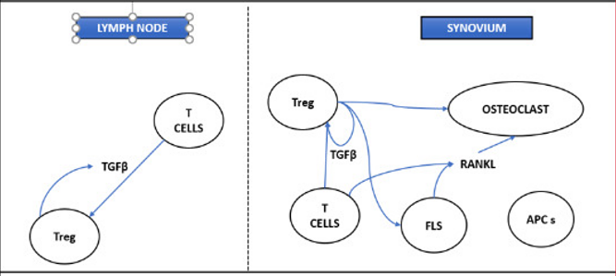
Diseased Healthy

Slide 5
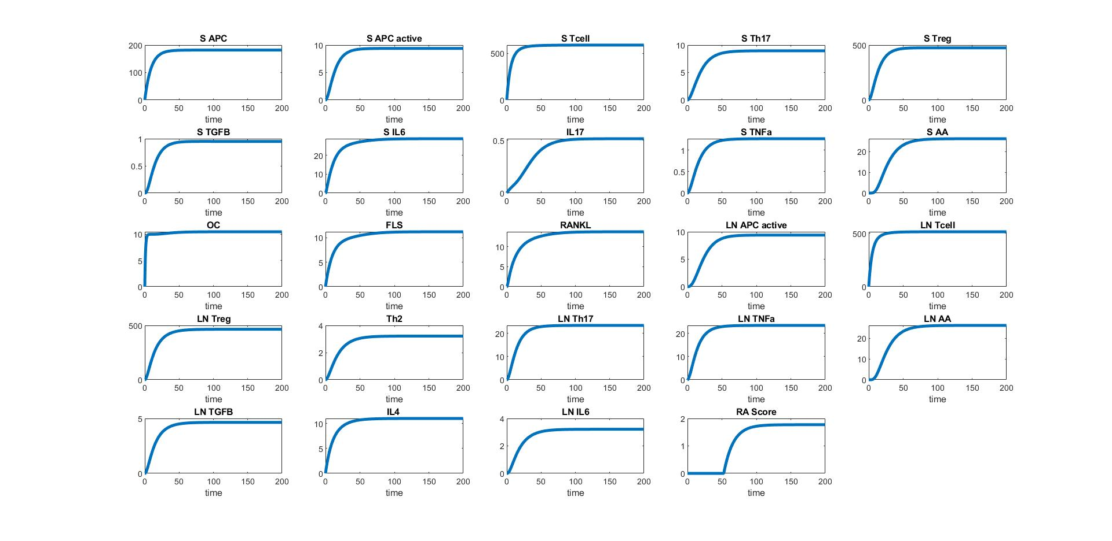
Healthy (Beta = 0)

Slide 6
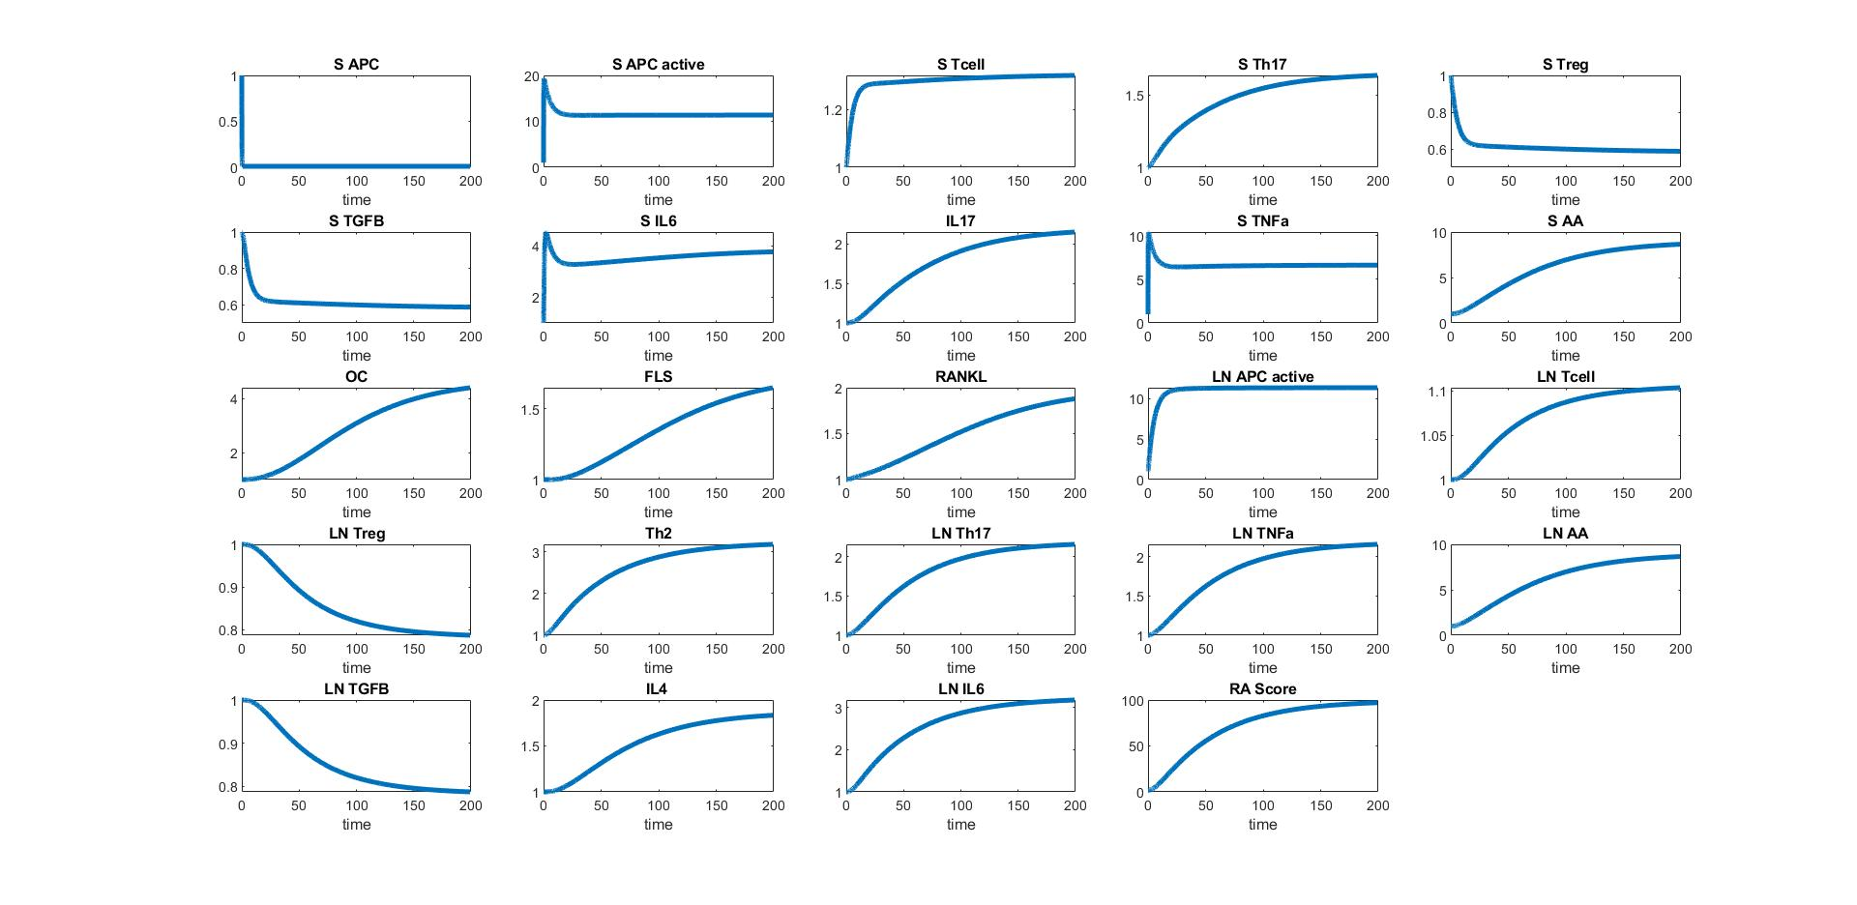
Diseased (Beta = 100)

Slide 7
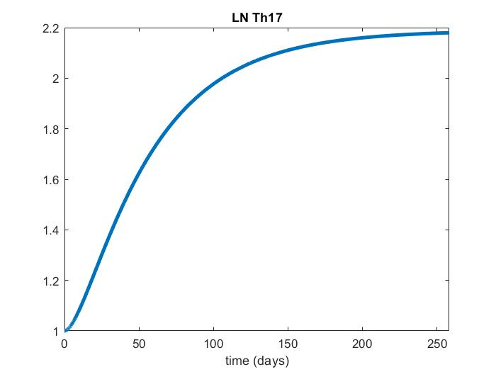
Lymph Node Th17
2.189
1.7
https://www.ncbi.nlm.nih.gov/pmc/articles/PMC3317658/

Slide 8
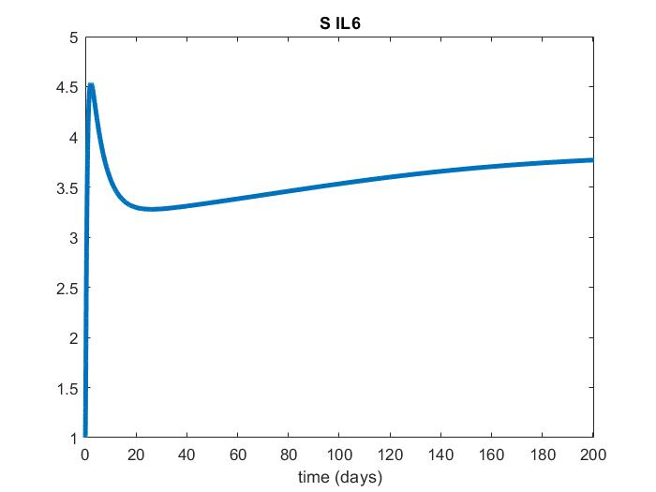
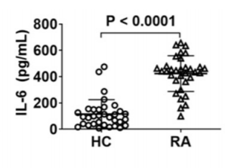
Synovium IL6
4
3.84
https://www.thno.org/v11p1446.pdf

Slide 9
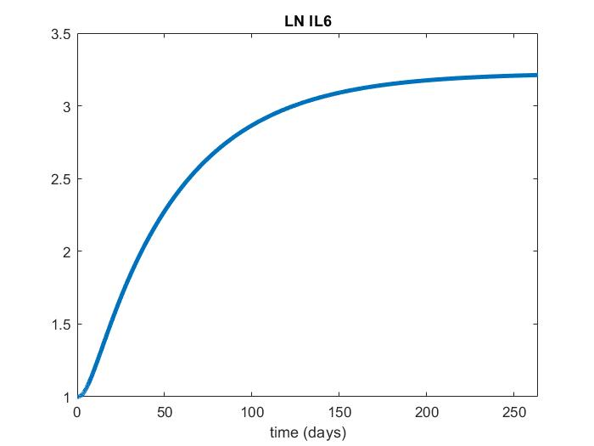
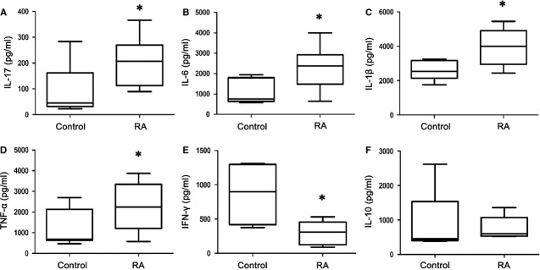
Lymph Node IL6
3.22
3
https://europepmc.org/article/pmc/pmc4224555

Slide 10
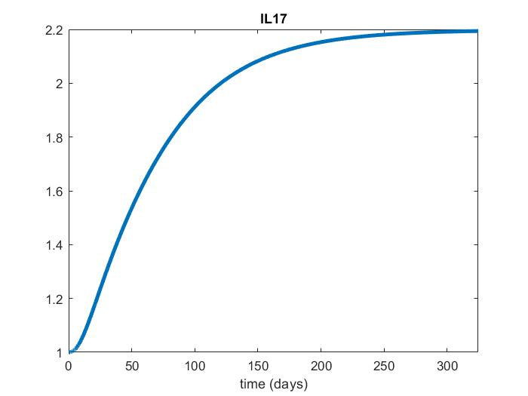
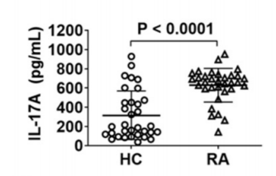
Synoviyum IL17
2.19
2
https://www.thno.org/v11p1446.pdf

Slide 11
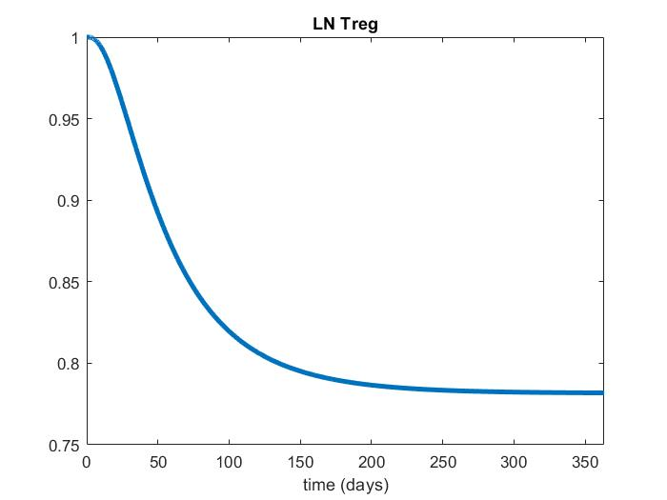
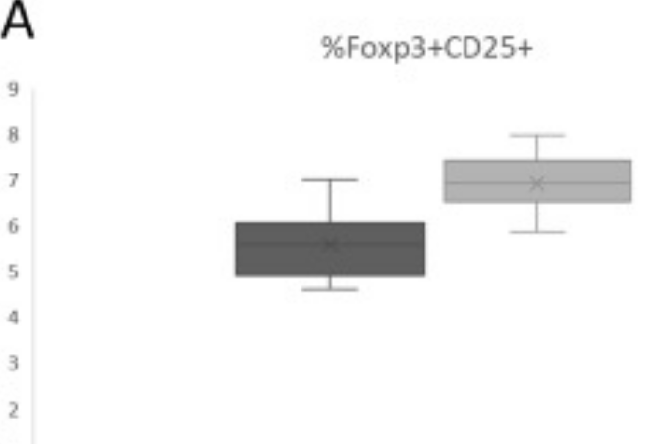
Lymph Node Treg
RA Healthy
(7/5.5) = 1.27
1.27
https://www.sciencedirect.com/science/article/pii/S0300908420300602

Slide 12

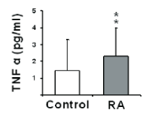
Lymph Node TNFa
2.6
2.18
https://europepmc.org/article/pmc/pmc4224555
https://www.researchgate.net/publication/46181922_Cytokines_of_the_Th1_and_Th2_type_in_sera_of_rheumatoid_arthritis_patients_Correlations_with_anti-Hsp40_immune_response_and_diagnostic_markers

Slide 13
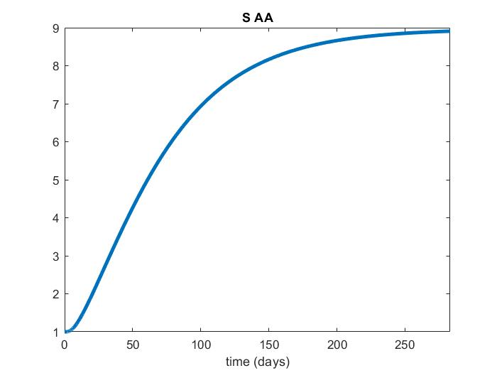
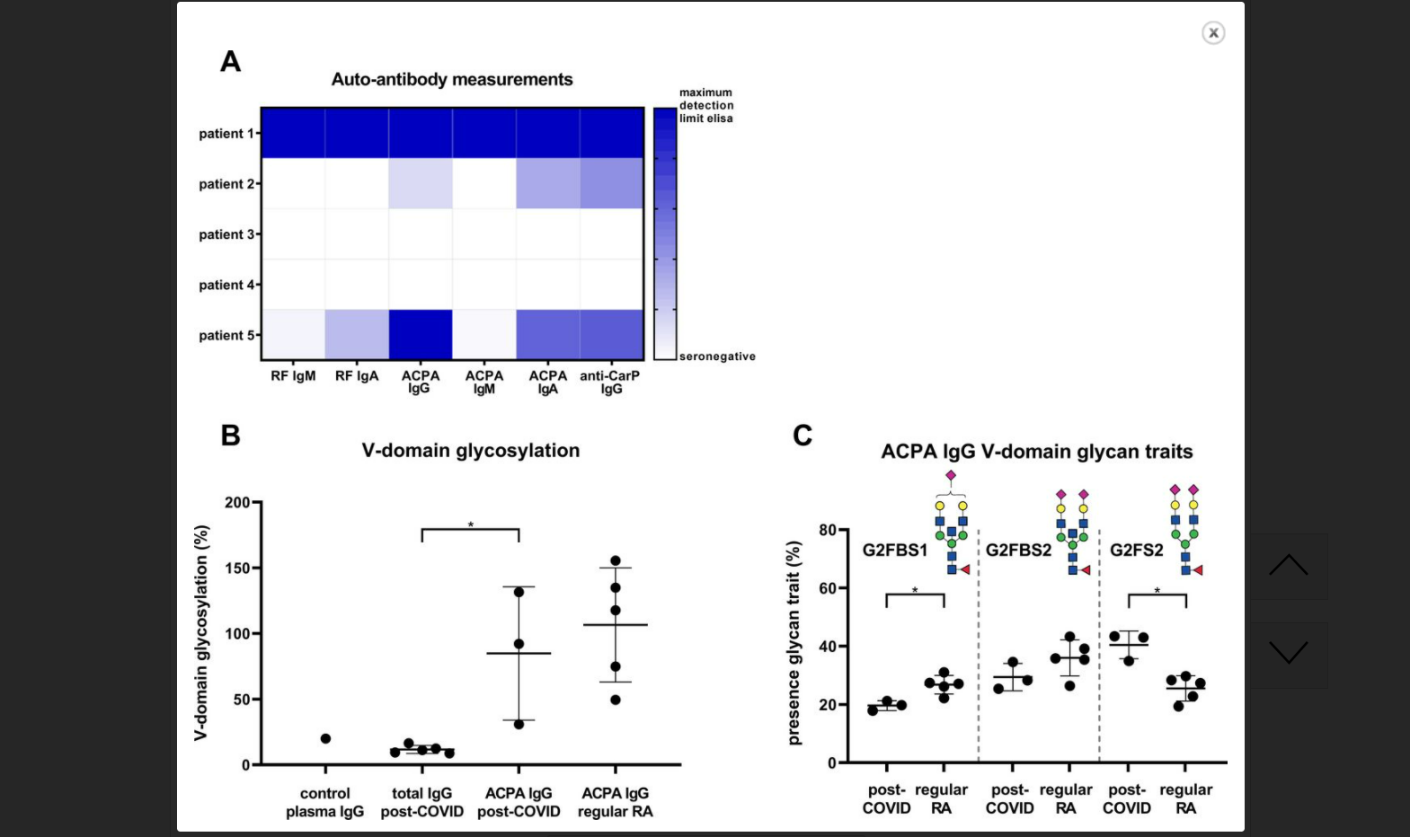
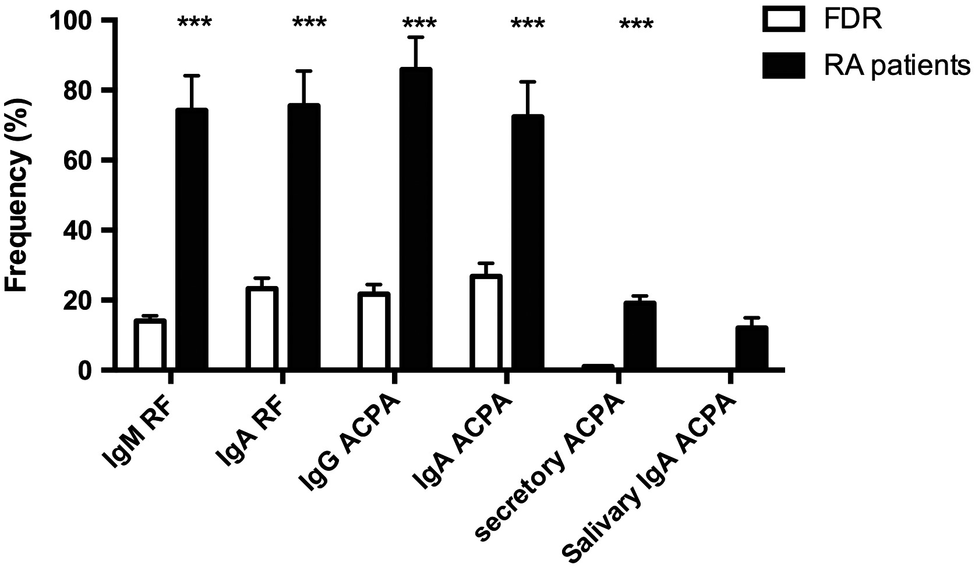
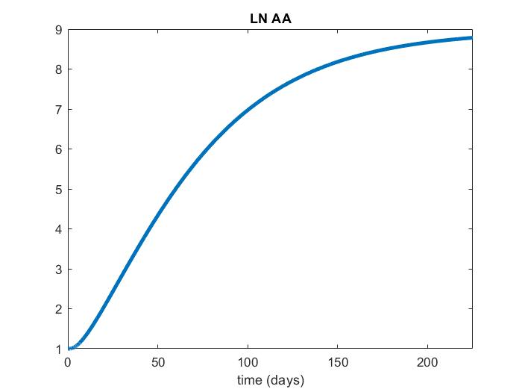
Synoviyum and Lymph Node Auto-Antibodies
8.97
8.97
https://doi.org/10.1111/cei.13381 https://ard.bmj.com/content/80/8/1096

Slide 14
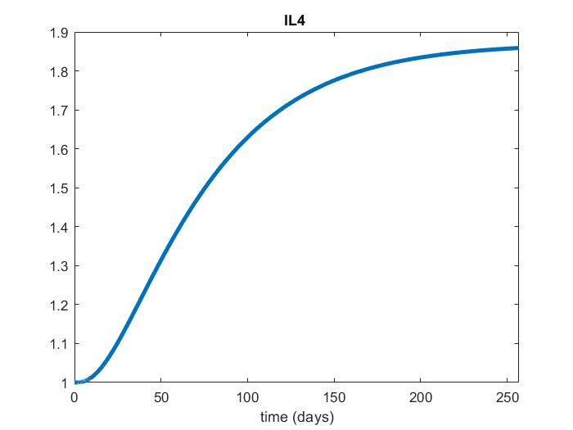
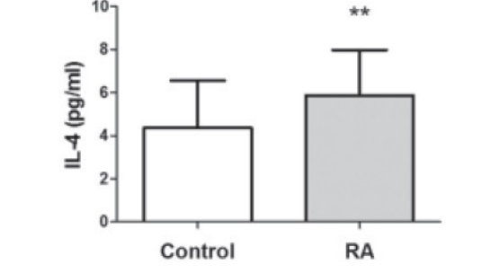
Lymph Node IL4
2.18
1.5
https://www.ncbi.nlm.nih.gov/pmc/articles/PMC3963318/

Slide 15
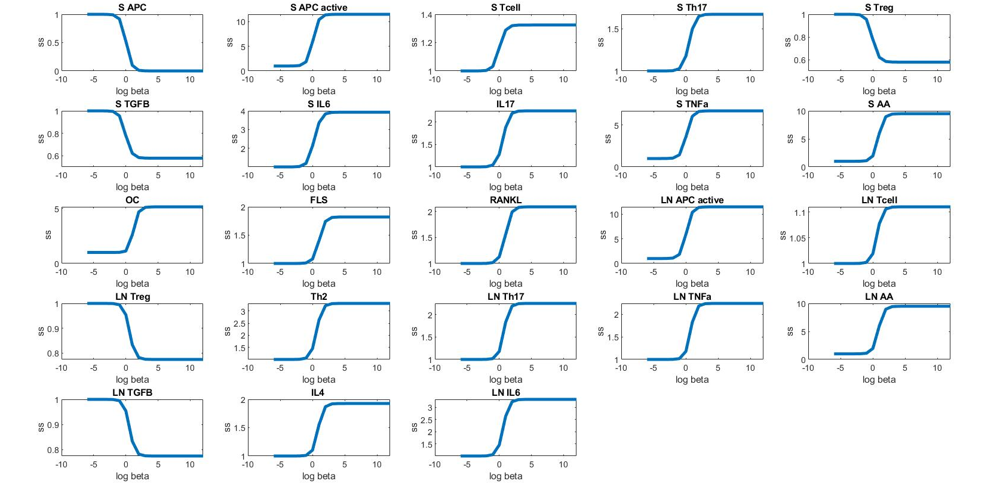
Bistability Plot

Slide 16
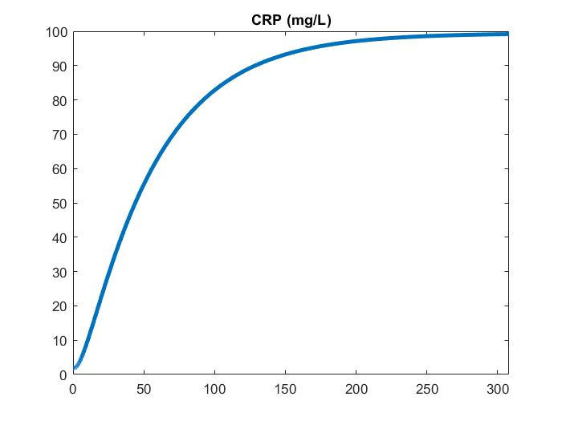
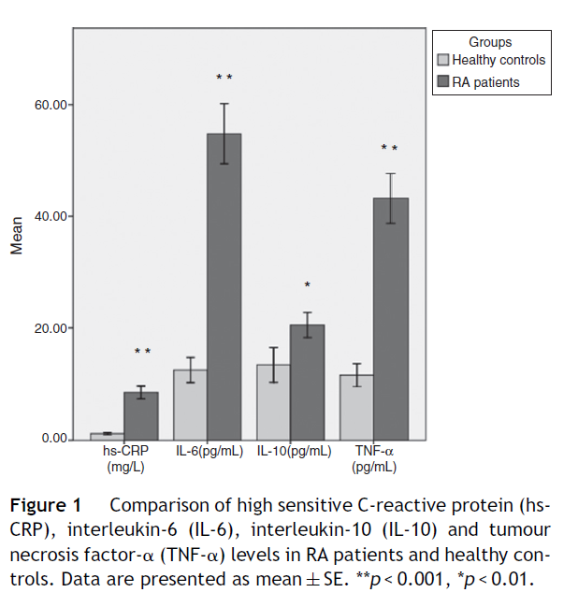
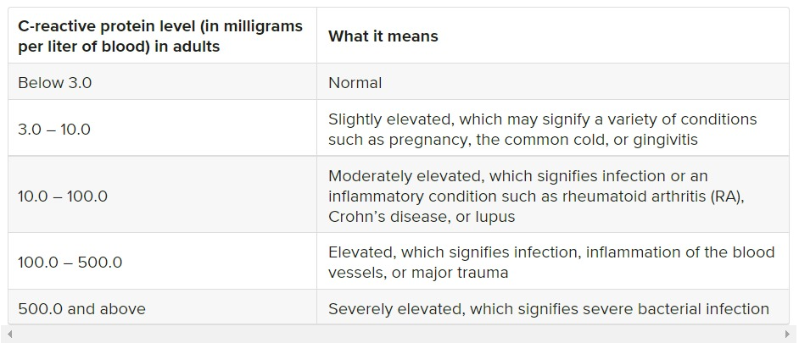
Clinical Outcome - CRP
https://www.sciencedirect.com/science/article/abs/pii/S0301054614000184
https://www.healthline.com/health/rheumatoid-arthritis-crp-levels#normal-crp-levels

Slide 17
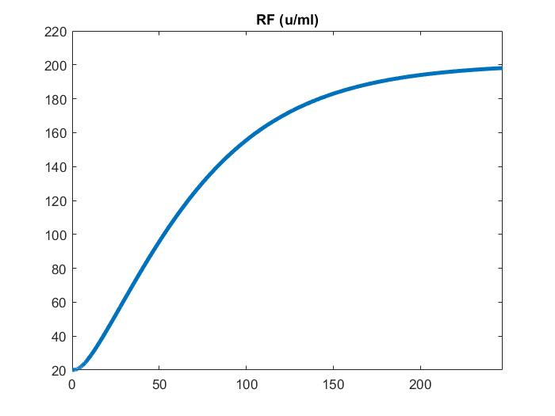
Clinical Outcome – Rheumatoid Factor
Main outcome measures
Rheumatoid arthritis according to baseline plasma IgM rheumatoid factor level categories of 25-50, 50.1-100, and >100, versus <25 IU/mL.
https://www.ncbi.nlm.nih.gov/pmc/articles/PMC3435445/

Slide 18
Sensitivity Analysis
The parameters were varied twice and half, five times and one-fifth
The parameters having the largest percentage change in CRP and RF values with respect to one times the parameter value are taken as sensitive parameters
Sensitive parameters includes →
Sensitive Parameters
LN Th2 Proliferation
LN Th17 Proliferation
APC active translocation from Synovium to LN
LN TNFa production from LN Th17
LN Th17 production from LN Tcell
S APC active proliferation by S AA
LN Th2 production from LN T cell
LN IL6 production from Th2
S APC active proliferation by S TNFa

Slide 19
Population Study
The sensitive parameters and the beta value was varied for different population sizes
Population size = 1000, 1500, 2000, 2500, 3000, 3500
Beta = varying

Slide 20
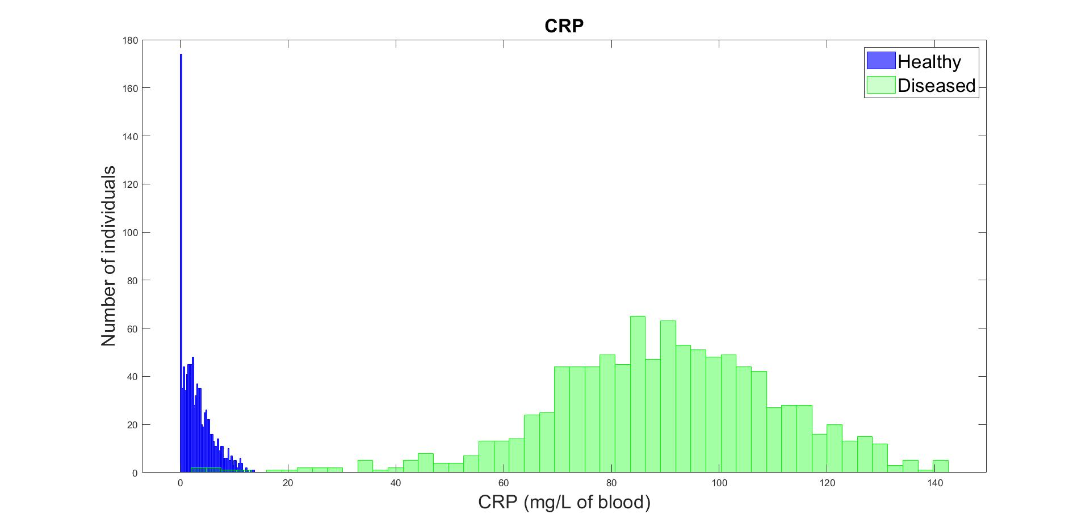
Population Size = 1000
Mean: 3.1416
Std: 2.8599
% < Mean = 58.8%
Mean: 89.5234
Std: 21.3726
% < Mean = 48.7%

Slide 21
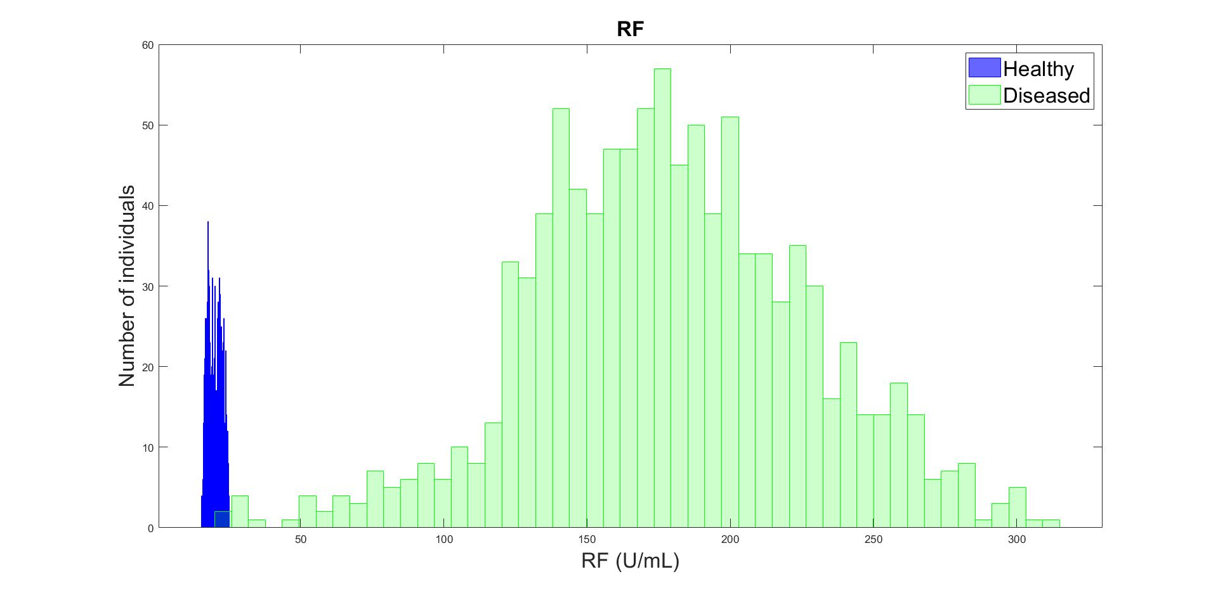
Population Size = 1000
Mean: 20.1342
Std: 2.4704
% < Mean = 50%
Mean: 178.3577
Std: 48.4731
% < Mean = 51.7%

Slide 22
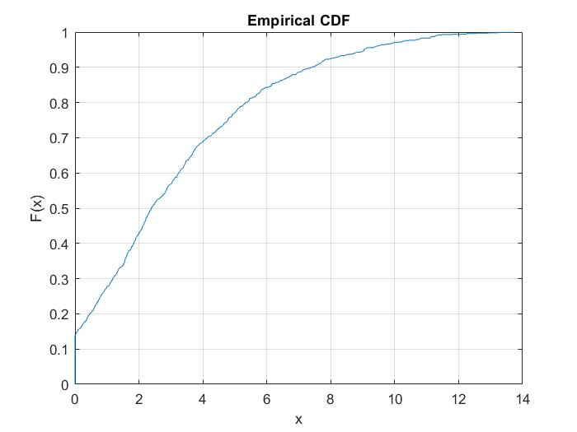
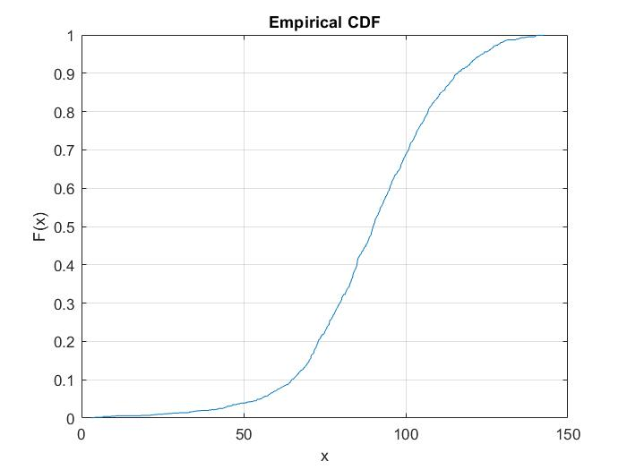
Cumulative Distribution Function - CRP
CRP Healthy
CRP Diseased
CRP Level
CRP Level

Slide 23
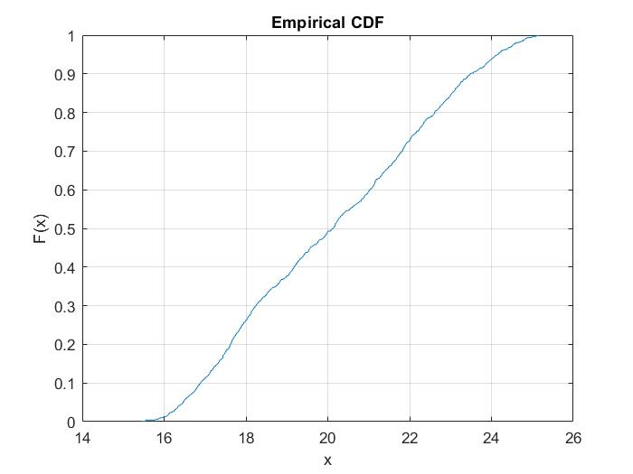
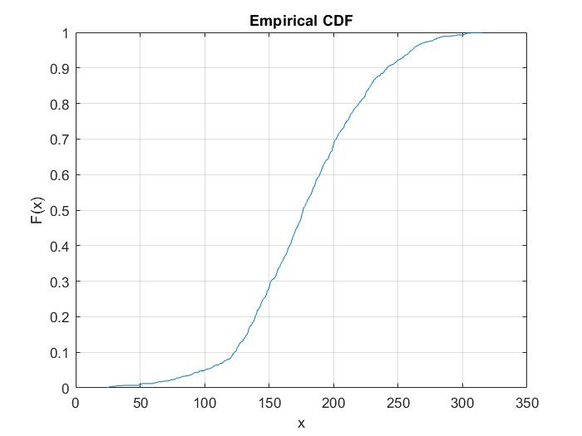
Cumulative Distribution Function - RF
RF Healthy
RF Diseased
RF Level
RF Level

Slide 24
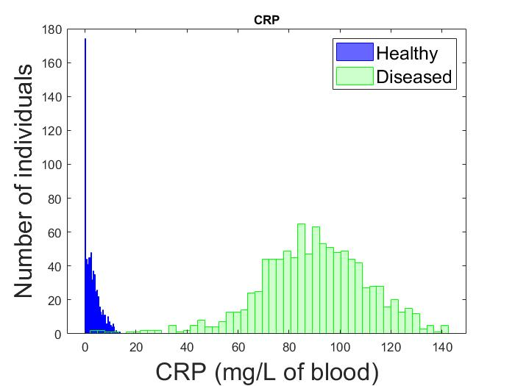
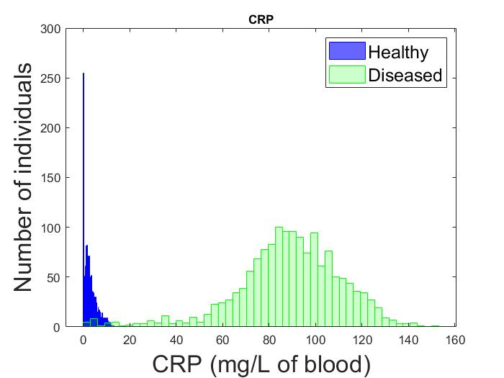
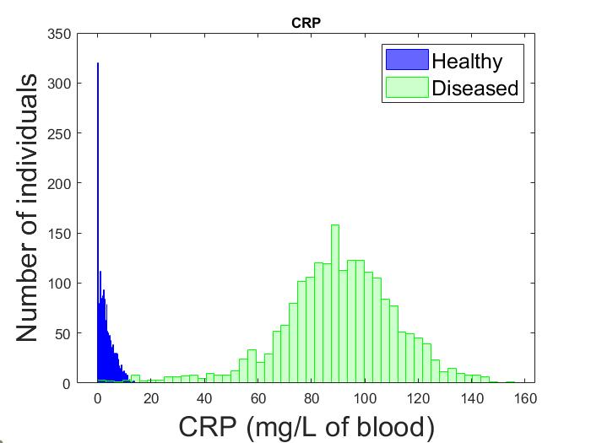

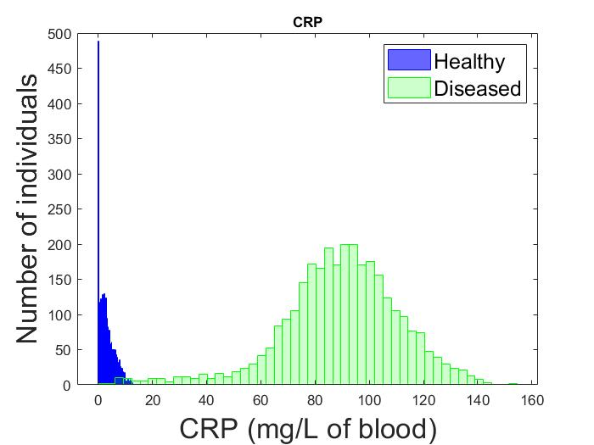
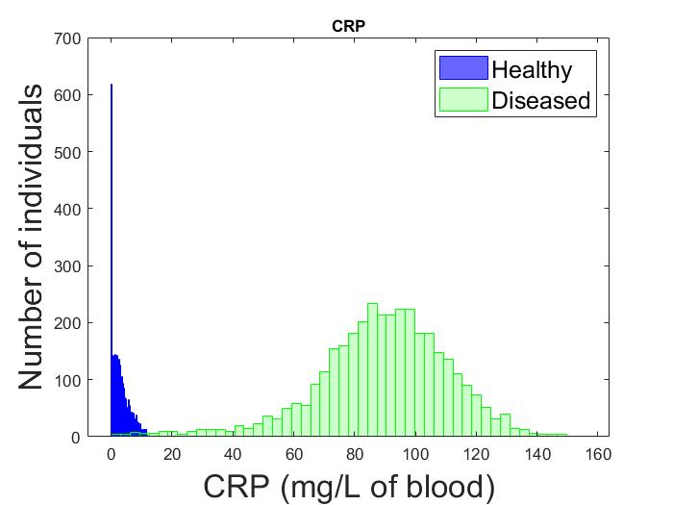
Pop Size = 1000
Pop Size = 1500
Pop Size = 2000
Pop Size = 2500
Pop Size = 3000
Pop Size = 3500

Slide 25
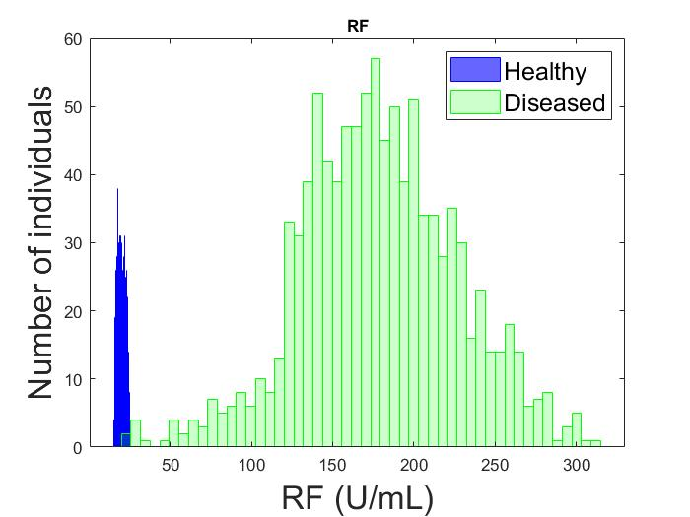
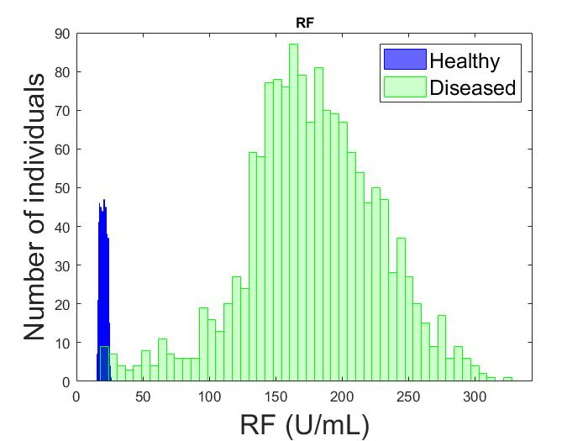
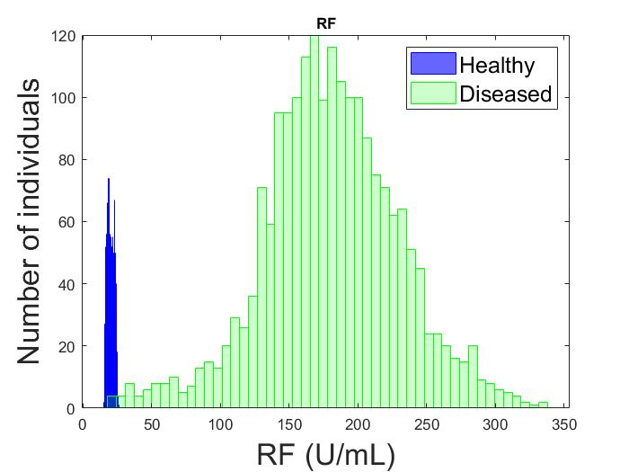
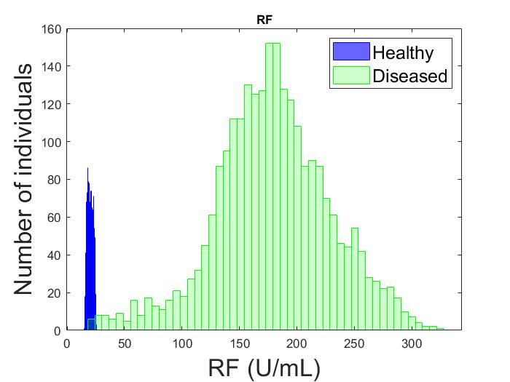
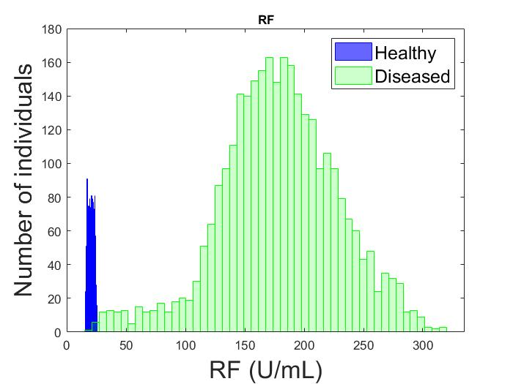
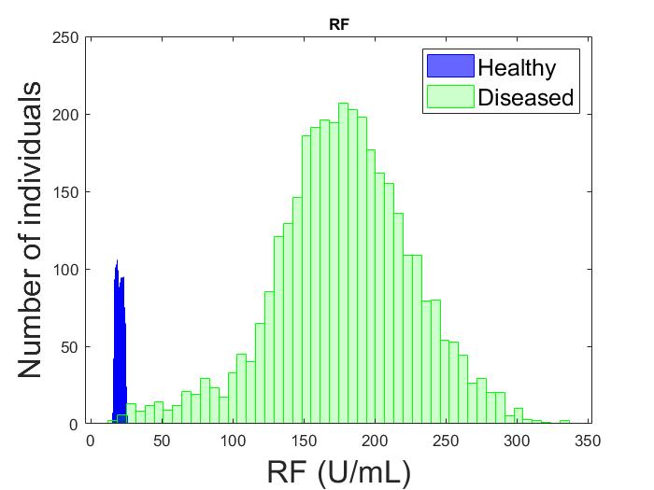
Pop Size = 1000
Pop Size = 1500
Pop Size = 2000
Pop Size = 3000
Pop Size = 3500
Pop Size = 2500

Slide 26
CRP
Mean and SD for different population size
Pop size = 1000
1500
2000
2500
3000
3500
Healthy
Mean: 3.1416
Std: 2.8599
Mean: 3.0330
Std: 2.7835
Mean: 3.1570
Std: 2.8116
Mean: 3.1247
Std: 2.8244
Mean: 3.1311
Std: 2.7749
Mean: 3.0828
Std: 2.8079
Diseased
Mean: 89.5234
Std: 21.3726
Mean: 88.5109
Std: 22.8446
Mean: 90.0918
Std: 21.8804
Mean: 89.4729
Std: 22.0474
Mean: 89.3223
Std: 22.2119
Mean: 89.1032
Std: 21.9612
RF
Mean: 20.1342
Std: 2.4704
Mean: 20.1132
Std: 2.4089
Mean: 20.1625
Std: 2.4546
Mean: 20.1131
Std: 2.4302
Mean: 20.1878
Std: 2.4548
Mean: 20.1359
Std: 2.4239
Healthy
Mean: 178.3577
Std: 48.4731
Mean: 177.2557
Std: 50.6212
Mean: 180.5171
Std: 49.7006
Mean: 179.0137
Std: 50.3202
Mean: 178.8430
Std: 49.7084
Mean: 178.0681
Std: 48.6969
Diseased

Slide 27
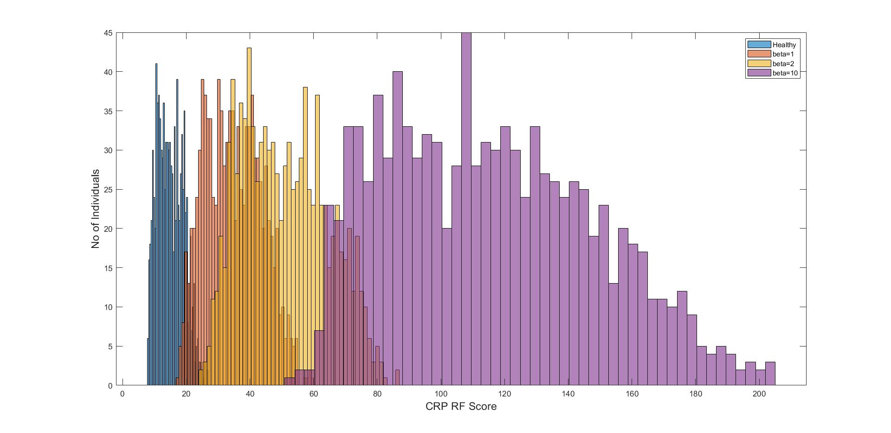
RA score

Slide 28
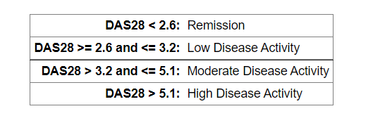
RA Score
Score Range
 | CRP | RF
Lower | Upper
0 | 17.66667
17.66667 | 36.66667
36.66667 | 100
100 | >100
Healthy | 0 to 3 | 0 to 25
Mild | 3 to 10 | 25 to 50
Moderate | 10 to 100 | 50 to 100
Critical | above 100 | above 100
beta | 0 | 1 | 2 | 10
Healthy | 71 % | 1 % | 0 % | 0 %
Mild | 29 % | 58.1 % | 16.6 % | 0 %
Moderate | 0 % | 41.8 % | 83.4 % | 38.1 %
Critical | 0 % | 0 % | 0 % | 61.9 %

Slide 29
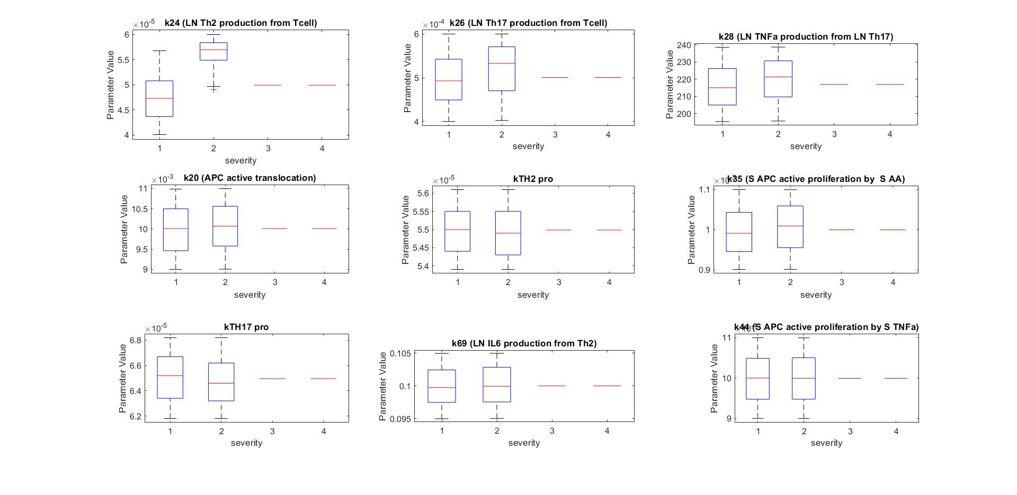
Parameter Range Vs Severity
Beta = 0
p = 1.97e-119
p = 2.26e-08
p = 2.76e-06
p = 0.086
p = 0.87
p = 0.0016
p = 0.997
p = 0.417
p = 0.0637
Wilcoxon rank sum test with significance of 0.05 left tailed
Severity = 1 – Healthy, 2 – Mild, 3 – Moderate, 4 – Critical

Slide 30
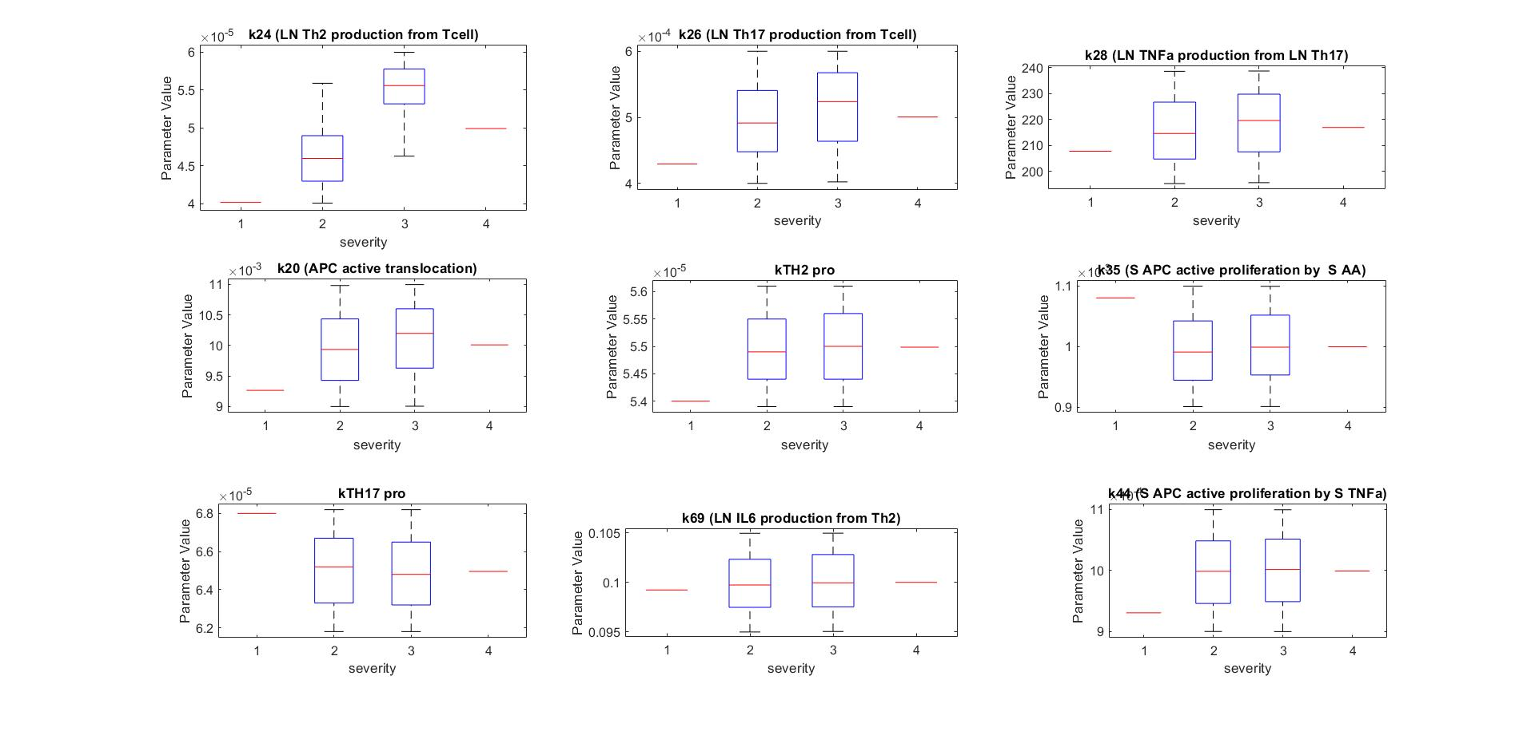
Parameter Range Vs Severity
Beta = 1
p12 = 0.0486, p23 = 9.5e-144, p13 = 0.0424
p12 = 0.1229, p23 = 1e-07 , p13 = 0.0896
p12 = 0.2798, p23 = 0.00016, p13 = 0.1984
p12 = 0.0621, p23 = 0.3289, p13 = 0.0628
p12 = 0.9260, p23 = 0.0176, p13 = 0.9182
p12 = 0.1193, p23 = 0.0001, p13 = 0.0950
p12 = 0.4221, p23 = 0.0707, p13 = 0.4005
p12 = 0.1135, p23 = 0.2817, p13 = 0.1313
p12 = 0.9420, p23 = 0.94202, p13 = 0.9443
Severity = 1 – Healthy, 2 – Mild, 3 – Moderate, 4 – Critical

Slide 31
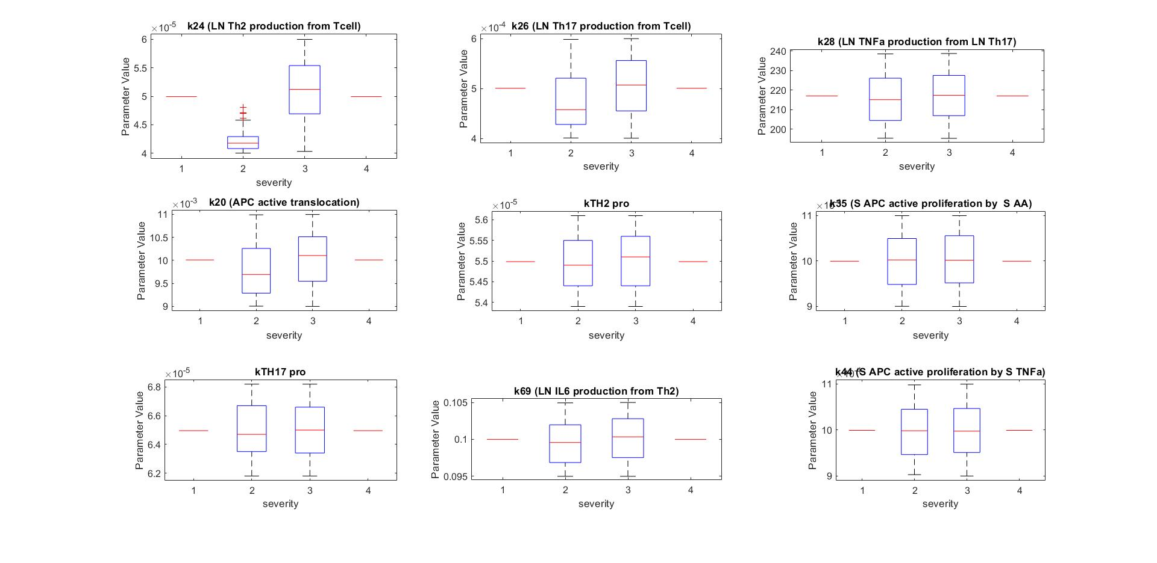
Parameter Range Vs Severity
Beta = 2
p = 1.175e-80
p = 1.369e-11
p = 0.026
p = 8.09e-07
p = 0.071
p = 0.334
p = 0.424
p = 0.331
p = 0.021
Severity = 1 – Healthy, 2 – Mild, 3 – Moderate, 4 – Critical

Slide 32
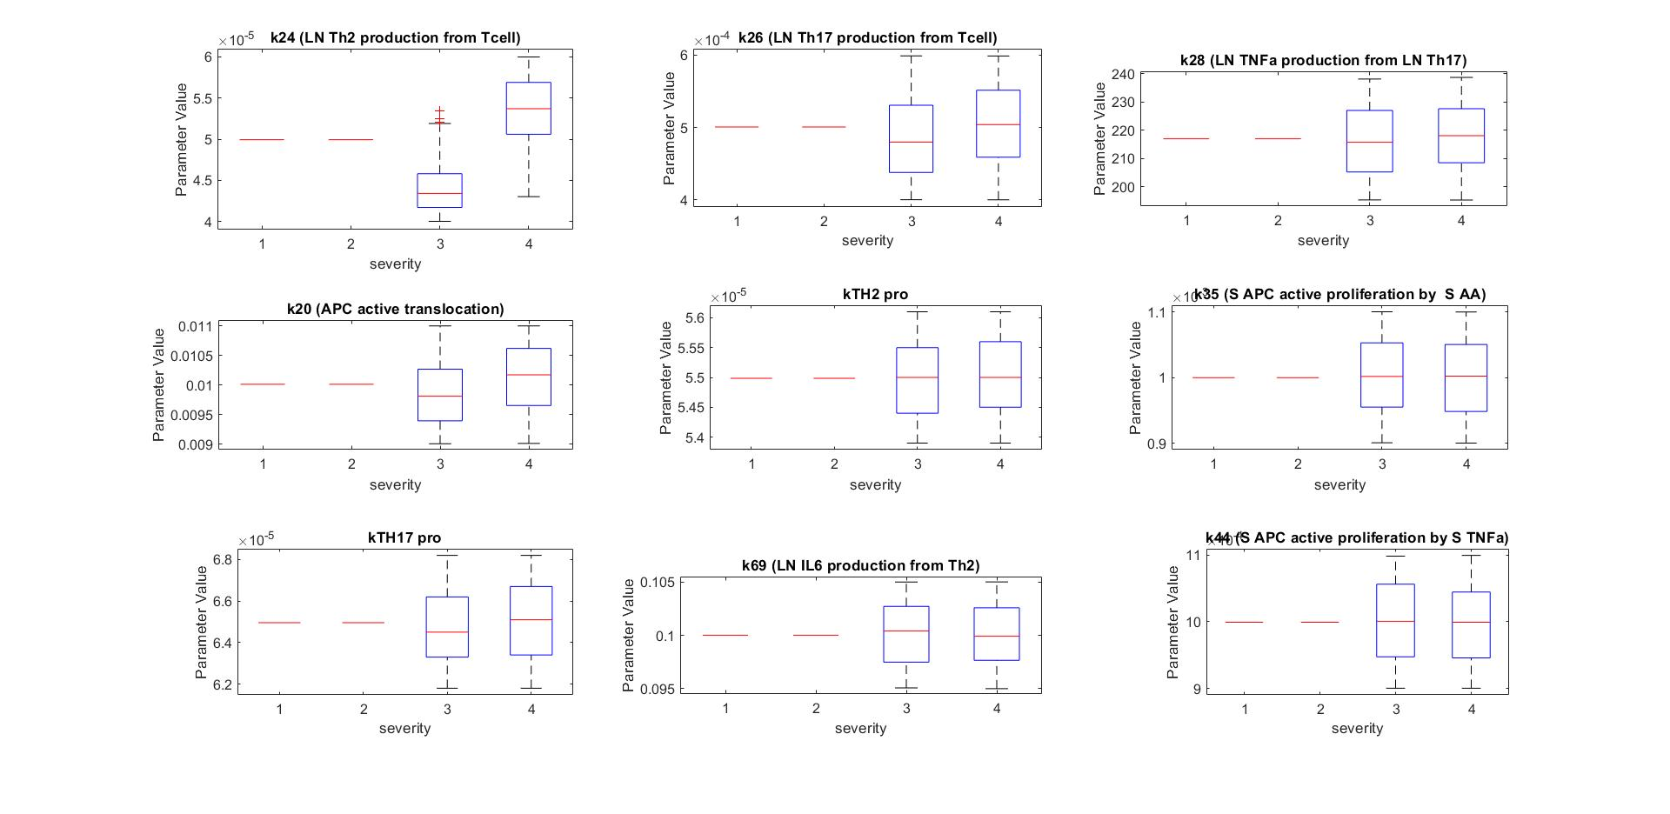
Parameter Range Vs Severity
Beta = 10
p = 3.075e-134
p = 8.93e-07
p = 0.0064
p = 9.338e-13
p = 0.039
p = 0.67121
p = 0.01202
p = 0.815
p = 0.790
Severity = 1 – Healthy, 2 – Mild, 3 – Moderate, 4 – Critical

Slide 33
Effect of Drugs in the Model
SMALL SYNTHETIC MOLECULES /
NON BIOLOGICS AGENTS
BIOLOGICS
Hydroxychloroquine (HCQ)
Azathioprine (AZA)
Sulfasalazine (SSZ)
Leflunomide
Methotrexate (MTX)
Cyclosporine
Gold salts
D- penicillamine
Minocycline
T cell Costimulation blockers
Abatacept
Belatacept
Anti‐B‐cell agents /
B cell depletion
Rituximab
Belatacept
Truxima
Rixathon
Atacicept
Tabalumab
Ofatumumab
IL‐1 inhibitors
Anakinra
Rilonacept
Canakinumab
IL‐17 inhibitors
Secukinumab
Ixekizumab
Brodalumab
OTHER BIOLOGICS
Quinazoline: VEGF inhibitor
CSF inhibitors
Pralia: RANKL Ab
Denosumab: osteoclast differentiation factor and RANKL inhibitor
Analgesics: Acetaminophen, tramadol, codeine, opiates
Mavrilimumab: GM-CSF inhibitor
TNF‐α inhibitors / TNF antagonists
Infliximab
Etanercept
Adalimumab
Certolizumab pegol
Golimumab
Amjevita
IL‐6 inhibitors
Tocilizumab
Sarilumab
Kevzara
Janus‐activated kinase (JAK) inhibitors
Tofacitinib
Baricitinib (Olumiant)
Upadacitinib (Xenleta)

Slide 34


Pharmacokinetics

Slide 35


Pharmacokinetics
IV injection 2 Compartment PK
Central Compartment
Time (days)
Effect Compartment
Time (days)
Time (days)

Slide 36
Tocilizumab
Parameter | Estimate
Fixed Effect
Ka, /day | 0.156
F | 0.745
CL , L/day | 0.3
Vc, L | 3.5
Q , L | 0.2
Vp, L | 2.9
VM, mg/day, | 7.5
KM, μg/mL | 2.7
https://www.ncbi.nlm.nih.gov/pmc/articles/PMC3908364/

Slide 37
Tocilizumab – Weight <100 kg: 162 mg SC every other week

Slide 38

Tocilizumab – DAS Score
https://www.ncbi.nlm.nih.gov/pmc/articles/PMC3908364/

Slide 39

Tocilizumab – Weight <100 kg: 162 mg SC every other week

Slide 40
Infliximab
Parameter | Estimate
Fixed Effect
CL , L/day | 0.456
Vc, L | 2.3
Q , L/day | 4.32
Vp, L | 3.6
https://bpspubs.onlinelibrary.wiley.com/doi/10.1111/bcp.12313

Slide 41
Infliximab – % 3.6 mg/kg 3.6 mg/kg for 70 kg = 252 mg
https://bpspubs.onlinelibrary.wiley.com/doi/10.1111/bcp.12313

Slide 42
Infliximab – % 3 mg/kg IV at 0, 2, and 6 weeks, THEN q8Weeks thereafter 3mg/kg for 70 kg = 210 mg

Slide 43

Infliximab – % 3 mg/kg IV at 0, 2, and 6 weeks, THEN q8Weeks thereafter 3mg/kg for 70 kg = 210 mg

Slide 44
Abatacept – % 125 mg SC qWeek
Parameter | Estimate
Fixed Effect
CL , L/day | 0.4896
Vc, L | 3.27
Q , L/day | 0.636
Vp, L | 4.26
Ka , /day | 0.0732
f | .805
https://www.ncbi.nlm.nih.gov/pmc/articles/PMC6585965/

Slide 45


Abatacept – % 125 mg SC qWeek
https://pubmed.ncbi.nlm.nih.gov/30229926/

Slide 46

Abatacept – % 125 mg SC qWeek

Slide 47

Tocilizumab – POP PK for N=10

Slide 48

Tocilizumab – N=10
Varying PK Parameters

Slide 49

Tocilizumab – N=10
Varying the Model parameters

Slide 50

Tocilizumab – N=10
Varying the PK and Model parameters

Slide 51

Drug Administration For 200 days
 | Diseased (before treatment) |  | Diseased (after treatment)
 | Mean | SD | Mean | SD
CRP | 101.06 | 23.03 | 53.84 | 20.90
RF | 211 | 59.12 | 145.12 | 45.78
RA score | 174.35 | 45.60 | 114.75 | 36.45
DAS score | 9.49 | 1.94 | 5.5 | 1.76

Slide 52
Genes in RA
Gene | Parameters in the Model | Function
HLA-DRB1 | Kn1, k31 | Macrophage polarization, RF factor
PTPN22 | k24, k26 and k54 | Tcell differentiation
TRAF1 | k28, k69, k64, k74 , k50 and k66 | Inflammatory response and auto antibodies
CTLA4 | k3 and k1 | Treg production disturbed
STAT4 | k28, k64 and k74 | TNFa
CCR6 | k24, k26 and k54 | Tcell differentiation
PADI4 | kn1 | Citrullination

Slide 53
HLA-DRB1
PTPN22

Slide 54
TRAF1
CTLA4

Slide 55
STAT4
CCR6

Slide 56
PADI4

Slide 57
30% increase
30% decrease

Slide 58
Estimating parameters from clinical outcome
CRP = 10 , RF = 15

Slide 59
Estimating parameters from clinical outcome
CRP = 60 , RF = 100

Slide 60
ThankYou

